Slide 1







AYU CITRA ISLAMI
Data Analyst Enthusiast

Slide 2




TABLE OF CONTENT
Introduction
Experience and Projects
Data Cleaning and Analysis
Data Vizualisation
Insight
Recommendation

Slide 3

INTRODUCTION
I'm a self-taught data analyst who seeking for new experience in data field. Have strong five years experience in sales, thus i have enough experience and skills such as business acumen, communication skills, strategic thinking and analytical skills that can be a huge help in my upcoming role. I completed mini course in Data Analytics held by Revou, and Coursera Google, and completed some projects while doing so. I am ready to face new challenges with my skills in SQL, Phyton, Tableau and Power BI.

Slide 4
PROJECTS
ASSOCIATE ACCOUNT MANAGER
RAENA BEAUTY
2021-2023
CUSTOMER DEVELOPMENT EXECUTIVE
PT PARAGON TECHNOLOGY AND INNOVATION
2017-2020
Completed :
Live Project Food Delivery App Data Analysis by HiCounselor (2023). Tools : Python, MySQL
Analyzing Spotify and Youtube Data by Hicounselor (2023). Tools : Python, MySQL
Translating business queries into SQL and build Sales Dashboard by Revou (2022). Tools : SQL Server Management Studio, Power BI
Enhance communication skills by doing upselling, cross selling, cold calls and presenting ideas
Working remotely with intercultural team within Indonesia, Singapore, and Bangladesh
Actively seeking for new potential reseller
Manage account and help reseller to grow (help to make promotion, enrich SKU, taking care of the availability in visibility in store)
Enrich business acumen by doing market and business research with customer
Negotiate, maintain and build long term relationship with customer
Lead sales team to achieve sales target
In charge of distribution and sales of Wardah, Make Over, Emina, and Putri
COURSES
Introduction to Data Analytics by Revou, November 2022
Data analytics by Coursera Google

Slide 5

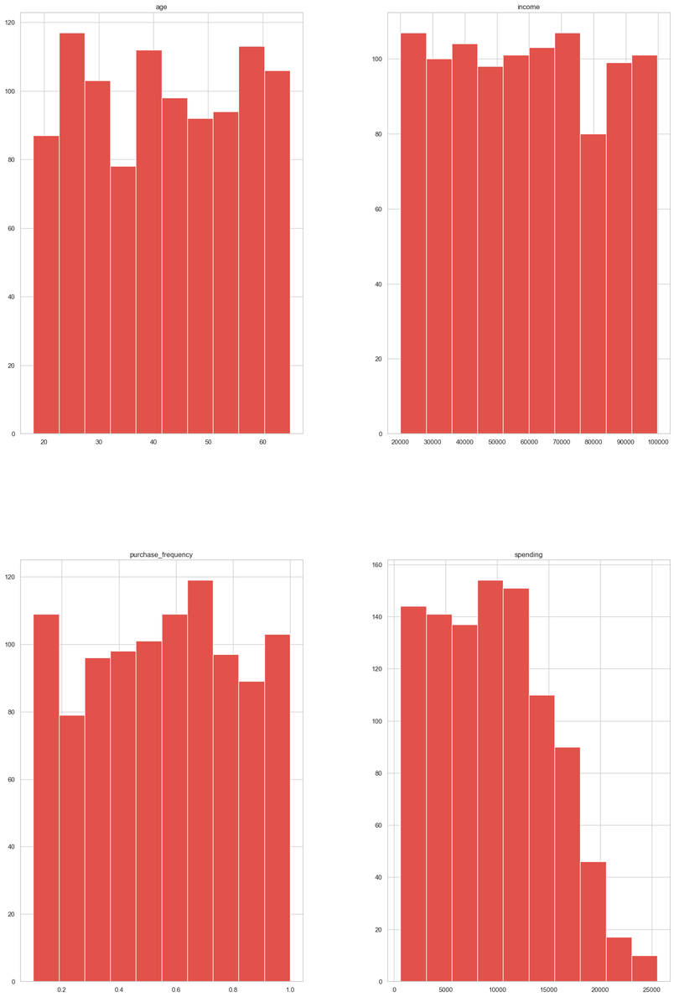
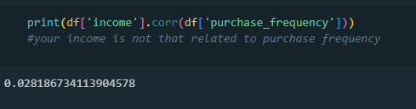
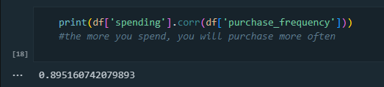
DATASET : CUSTOMER SPENDING
Data cleaning and analysis phase :
Correlation Analysis
Creating histogram plot
to see the distribution of the dataset
Tools used : Phyton
Data Source : Customer spending in Kaggle

Slide 6
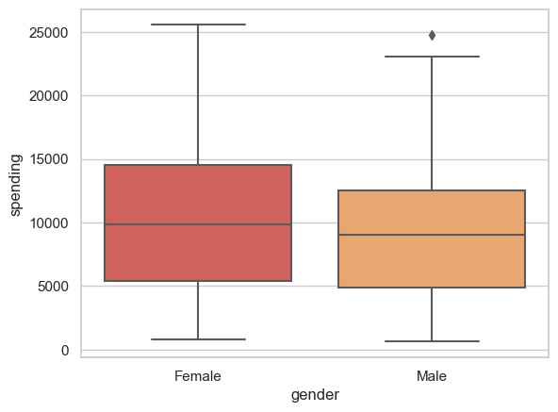
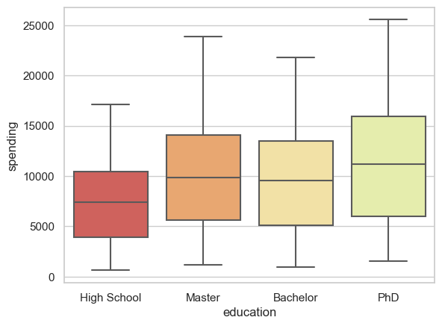
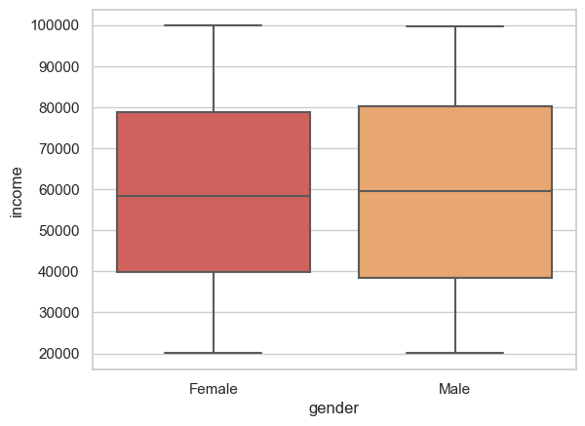
DATASET : CUSTOMER SPENDING
Tools used : Phyton
Exploratory data analysis
using boxplot
Gender vs spending and income
Female tends to purchase more than male,
eventhough Male's income is much higher than Female
The higher education of customers more likely affecting the spending

Slide 7
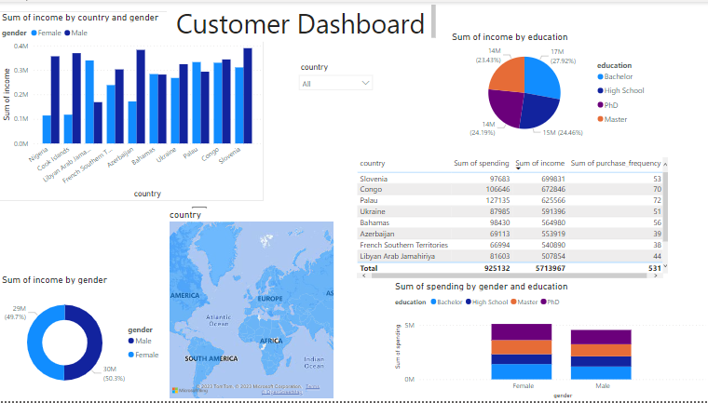
Data Vizualisation
Tools used : Power BI
This dashboard shows income, spending and purchase frequency from several countries, divided by education and gender. We can analyze customer spending per countries by choosing from the dropdown

Slide 8
INSIGHT
Income has low correlation value to purchase frequency, but income highly affect spending
Female tends to purchase more than male, eventhough Male's income is much higher than Female
The higher education of customers more likely affecting the spending
Slovenia has the highest value in income, but Palau has the most spending due to the frequency of purchase
There are countries with huge gap between male's and female's income, but in total it's almost the same
in total, customer in bachelor degree have the most income to spend, but customer with PhD degree tend to spend more rather than other customer

Slide 9
RECOMMENDATION TO COMPANY
We need to double the frequency of spending per customer, since several countries already have a good amount of income
We can focus to female customer as the Female tends to purchase more than male, and create another pool of potential income from male customer
Focus on countries with the highest value in income to create more customer, meanwhile for countries that have great spending and frequency of purchase we can create loyalty program
For the next campaign we can focus on customer with bachelor degree by giving referral program to engage more new customer and create aftersales program for customer in PhD since they already have good amount in spending

